Slide 1
Best Saxophone Solos in Pop Music
Ryan Marawala

Slide 2
Criteria
Not a “hook” or “melody line”
Feels improvised
Somewhat popular song
Extremely subjective and biased ;)

Slide 3
Best Short Solo - “Kokomo” by the Beach Boys (1988)
Link: https://youtu.be/fJWmbLS2_ec?si=IpSsPWtkC6m7-gwJ&t=111

Slide 4
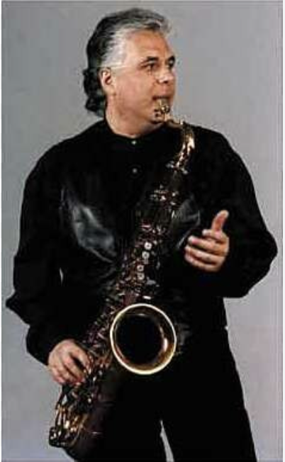
Best Short Solo - “Kokomo” by the Beach Boys (1988)
Take-Home Points of Joel Peskin’s Playing:
Rhythmic variation
Very expressive
Plays around with timbre
Brings out the progression
Makes great use of the 16 seconds

Slide 5
Best “Nasty” Solo: “Money” by Pink Floyd (1973)
Link:
https://youtu.be/-0kcet4aPpQ?si=MlchqD4Q7NJJfPaf&t=84

Slide 6
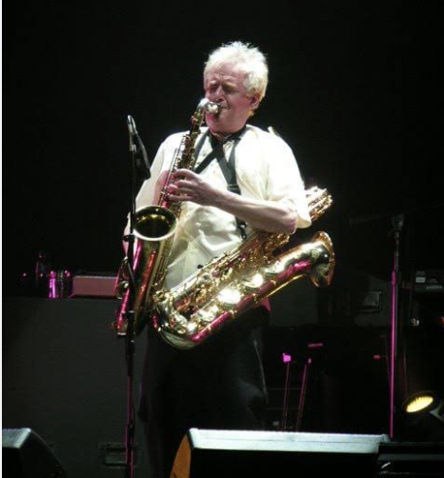
Best “Nasty” Solo: “Money” by Pink Floyd (1973)
Take-Home Points of Dick Parry’s Playing:
Great “bluesy” playing
Use of space
Growling and flutter tongue
Uses a lot of the instrument’s range and technical capabilities

Slide 7
Best “Bluesy” Solo: “Deacon Blues” by Steely Dan (1977)
Link:
https://youtu.be/OyCDicG0tDs?si=nIJcl8pRmQ69bMtM&t=222

Slide 8
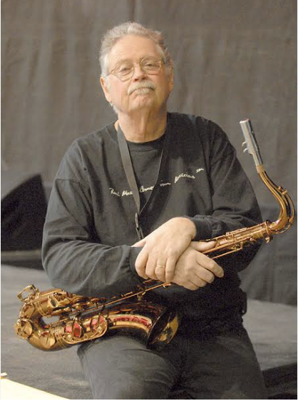
Best “Bluesy Rock” Solo: “Deacon Blues” by Steely Dan (1977)
Take-Home Points of Pete Christlieb’s Playing:
Sparse blue licks so they come out stronger
Rhythmic flow
Buttery sound
Great phrasing
Funky note choices
Motif building

Slide 9
Best “Psyche, This is Actually Jazz” Solo: “Just The Two of Us” by Grover Washington Jr. (1980)
Link:
https://youtu.be/6POZlJAZsok?si=VWNWu7te03nz9zv0&t=171

Slide 10
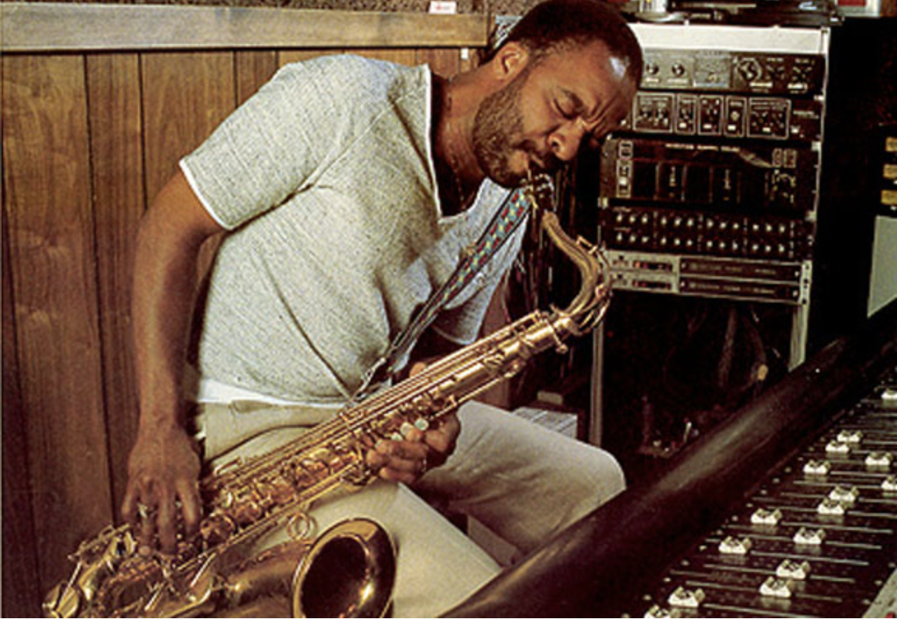
Best “Psyche, This is Actually Jazz” Solo: “Just The Two of Us” by Grover Washington Jr. (1980)
Take-Home Points of Grover Washington Jr.’s Playing:
Motif building / Loves to stick with a good phrase
Good use of full instrument
Also a fantastic buttery sound
Knew what the people wanted

Slide 11
Best “Overall Pop” Solo: “Just The Way You Are” by Billy Joel (1977)
Link:
https://youtu.be/HaA3YZ6QdJU?si=aIsxQXh6eMukP3Yt&t=151

Slide 12
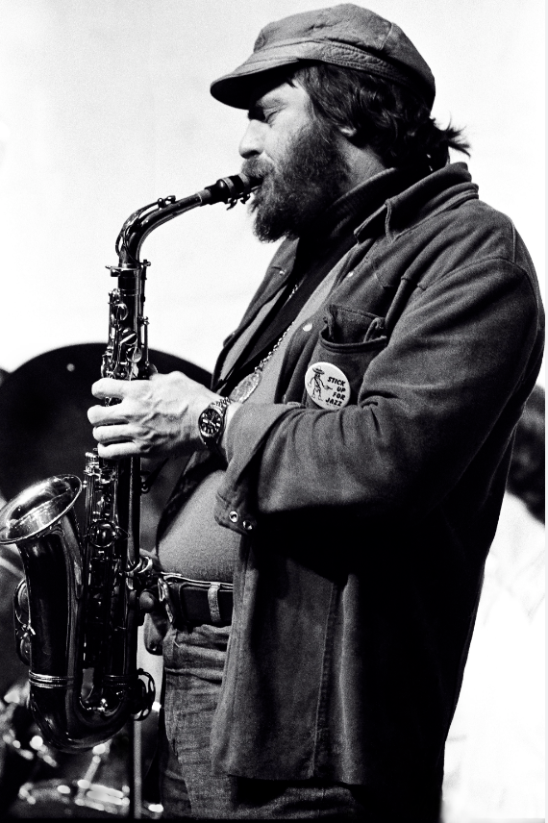
Best “Overall Pop” Solo: “Just The Way You Are” by Billy Joel (1977)
Take-Home Points of Phil Wood’s Playing:
Amazing transition out of written material
Motif building
“Bebop” style playing while also bringing out the ballad nature of the song
Brings out the beauty of the progression
Just a beast in general

Slide 13
In Conclusion
It’s very easy to make a solo stale and repetitive
These performers were able to contribute something new and different to each of the songs that they were a part of
In case you were worried that saxophone solos were a thing of the past…

Slide 14
“Moanin’” By Charles Mingus (Solo by Leo P) (2017)
Link: https://www.youtube.com/watch?v=BrmeOWbyOXw&ab_channel=GeorgeCollier

Slide 15
Thank you!

