Slide 1
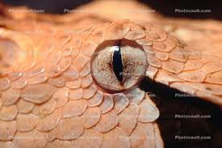
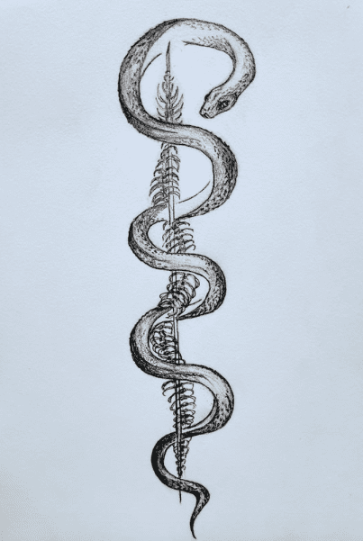
Ian’s Toxic Trait!
…and perhaps the perfect profession!

Slide 2
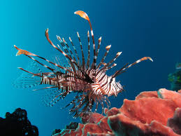
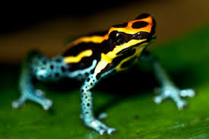
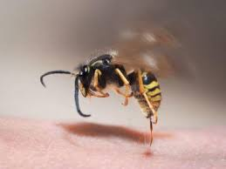
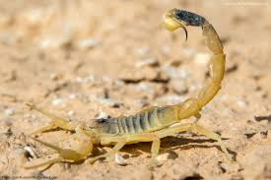
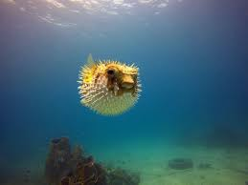
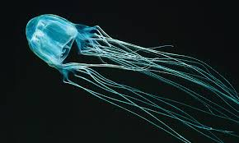
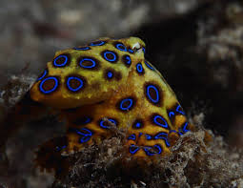
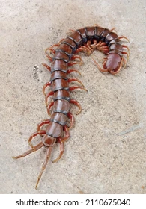
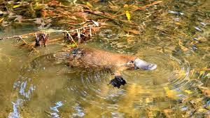
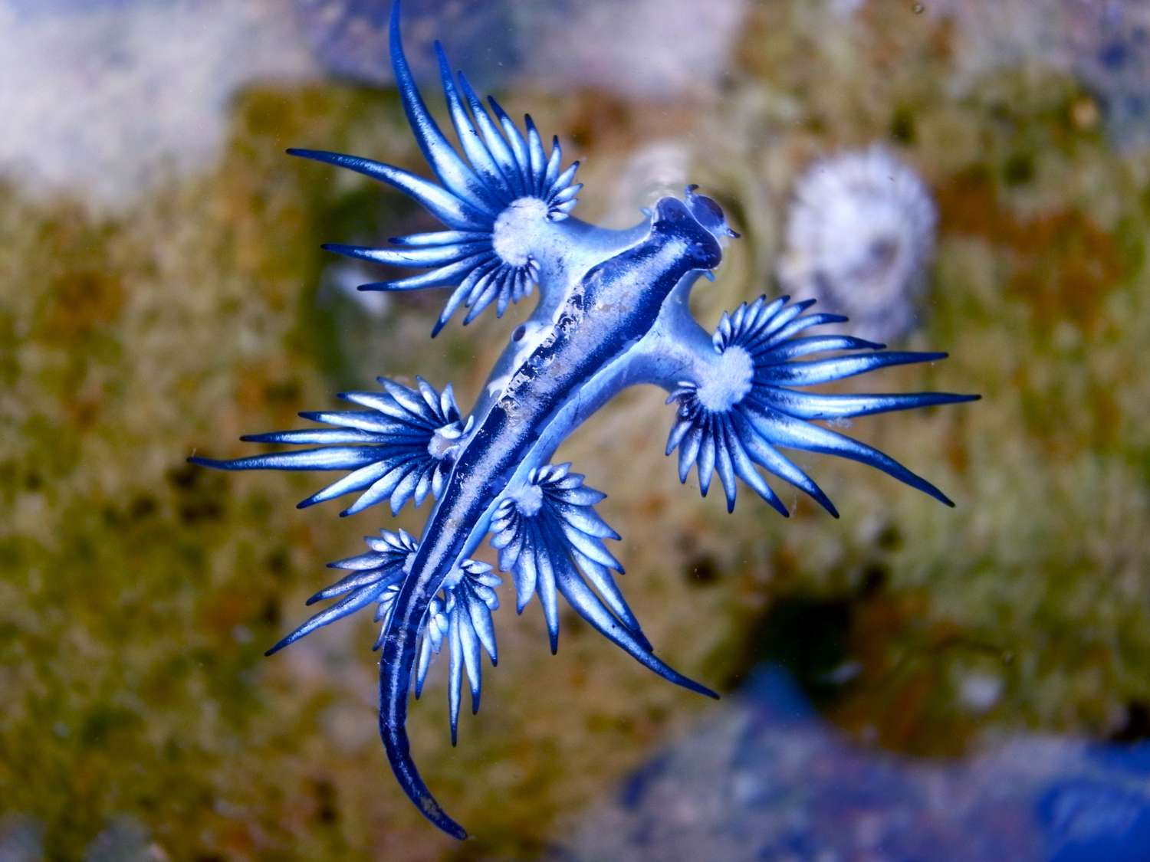
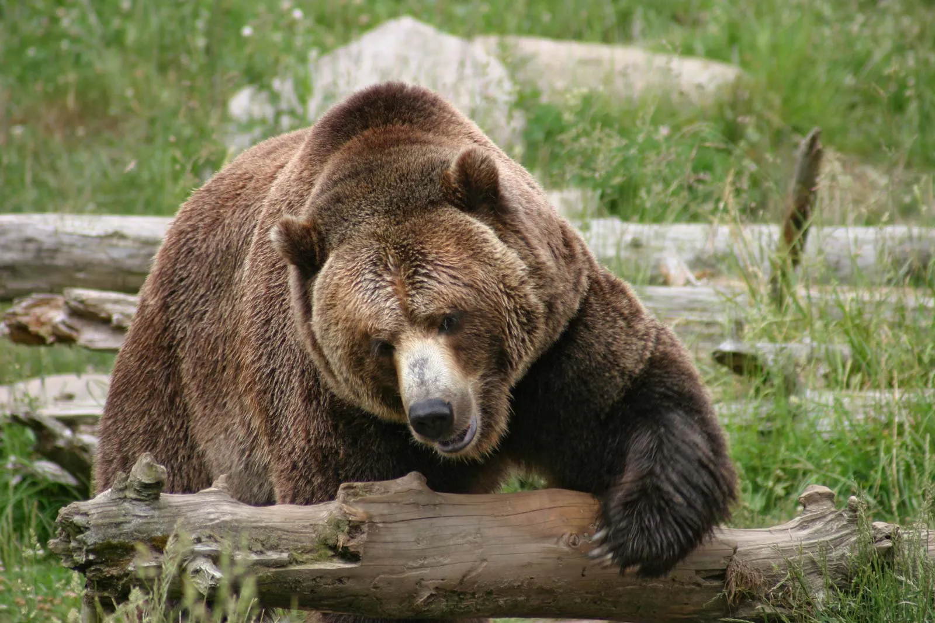
A Love Of Venoms & Poisons!

Slide 3
A Love Of Venoms & Poisons!
X
GOTCHA!!!

Slide 5
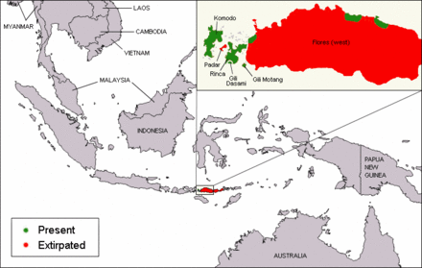
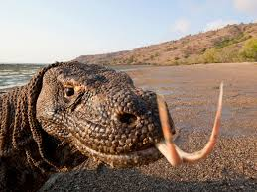
Komodo Dragons
An Old Favorite!

Slide 6
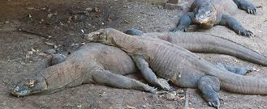
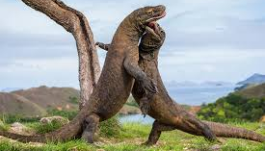
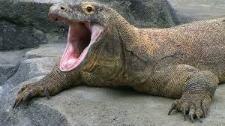
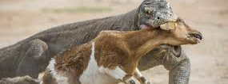

Slide 7
The Facts!
Venomous? Indeed! Understanding really came to the floor in 2005
10 ft lizard, 150 pounds
Parthenogenesis
Invertebrates, birds, mammals on the menu
Serrated teeth, claws, sensitive forked-tongue
All cones, no rods (Poor night vision
Just a stapes, limited hearing range (400-2,000 hz, humans: 20-20,000
Conservation, please be respectful

Slide 8
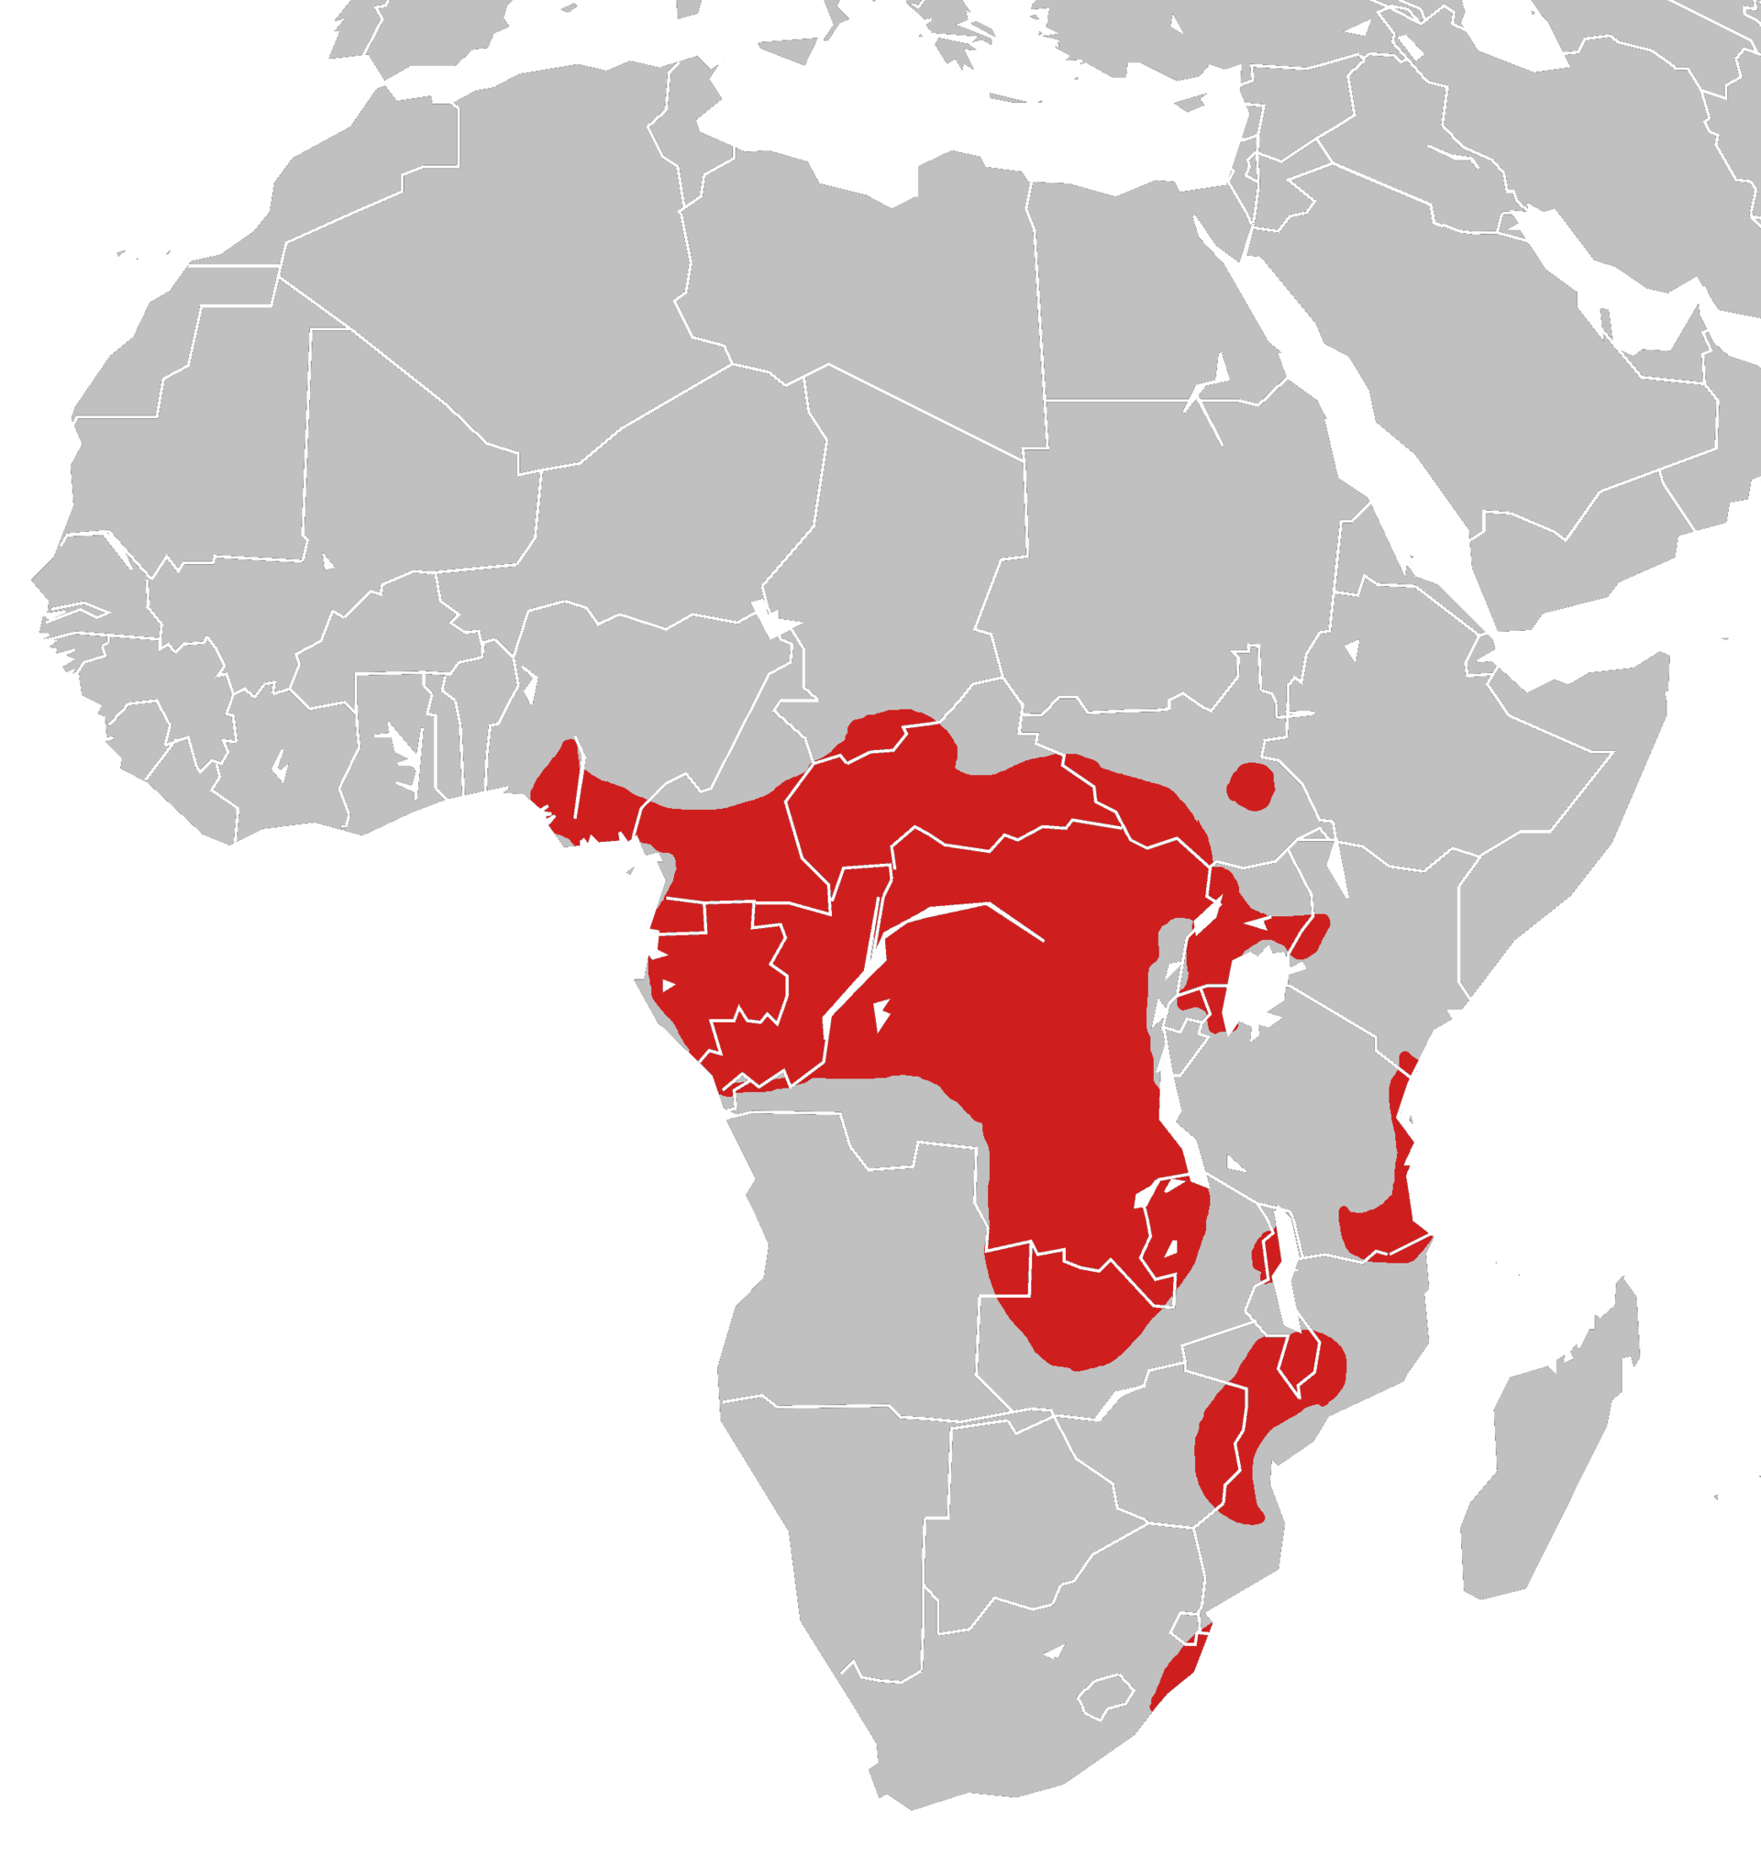
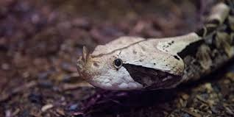
Gaboon Viper
A Gentle Giant

Slide 9
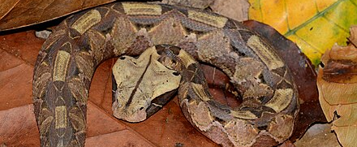
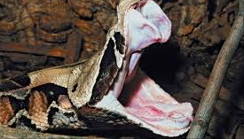
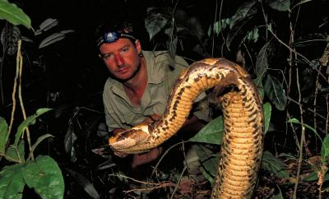
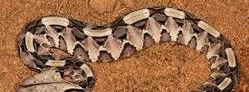

Slide 10
The Facts!
Longest fangs of any snake! (2 inches)
Heavy and stout. 19lbs. 4-5ft in length
Hide in dead leaves. Camouflage. Ambush!
Kind of a pacifist
Enormous venom glands. 2nd largest quantity of venom
Don’t release after bite, extra venom
Cardio and cytotoxic
Swelling, pain, shock, blistering, uncoordinated movements, defecation, urination, convulsions, swelling togue/eyelids, necrosis, hypotension, heart damage, inhibit coagulation
Excision of impacted tissue, amputation
All bites are an emergency. Require antivenom

Slide 11
Large Spider W/ Fangs

Slide 12
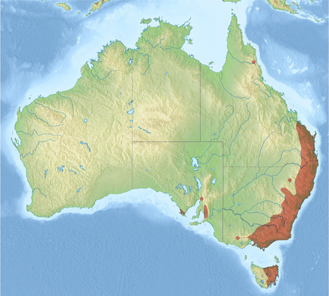
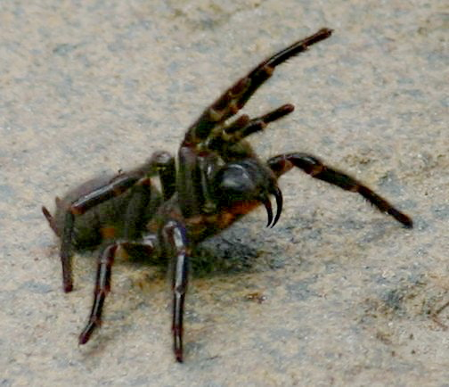
Sydney Funnel-Web
Sooooo Australia!

Slide 13
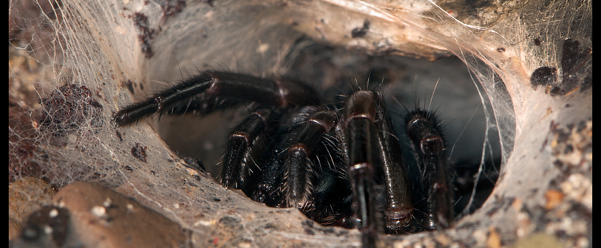
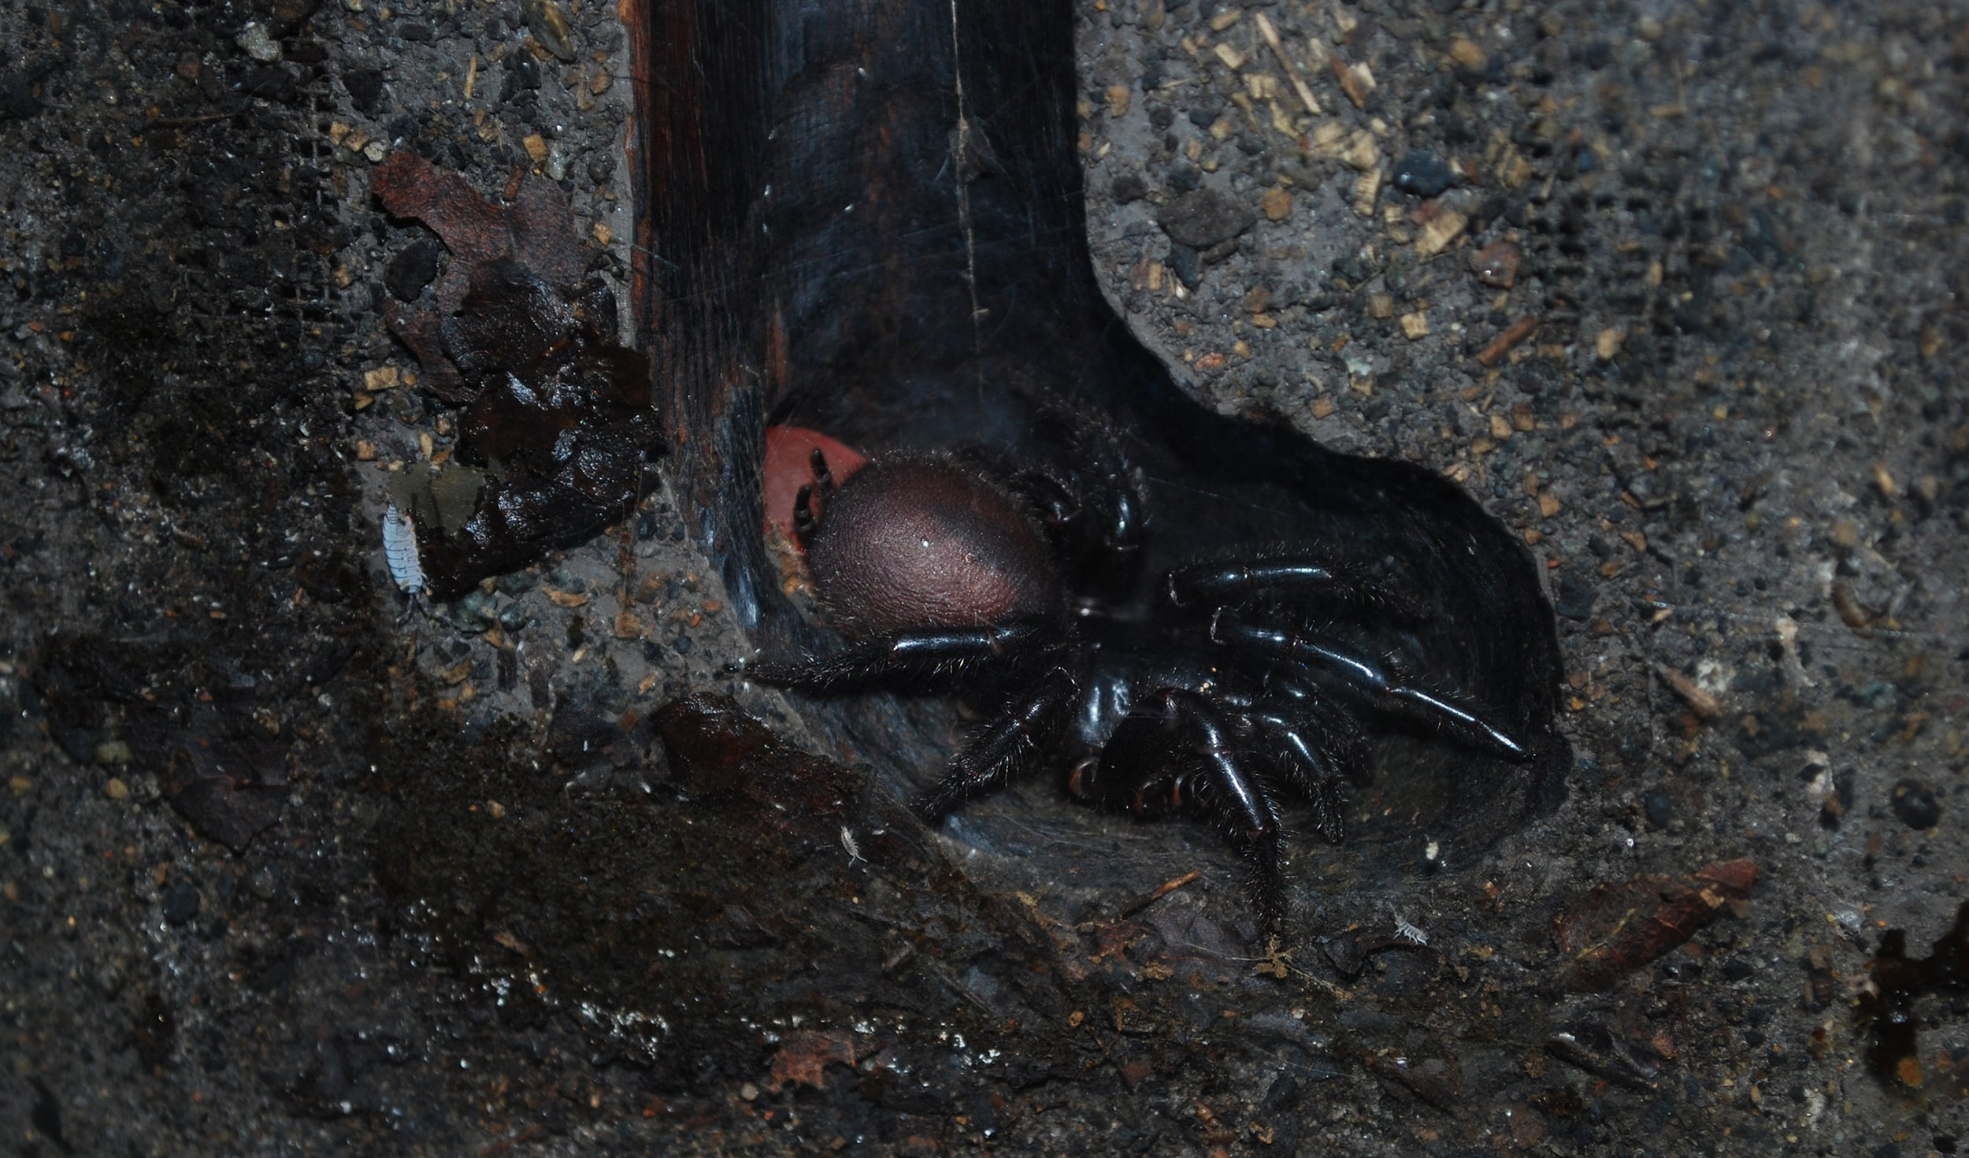
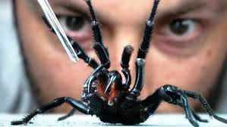

Slide 14
The Facts!
Longest fangs of any spider!
Can pierce fingernails and shoes, wear boots!
Burrow with irregular silk trip lines radiating from den
Do NOT have a lid on den, unlike trapdoor spiders
Medically significant spider due to toxicity and leathality
Usually males traveling to find females
Attracted to water/swimming pools, can bite when removed (survive for hours)
Pain from fang size. Final stages of envenomation include, dilated, fixed pupils, generalized muscle twitching, unconsciousness, elevated intracranial pressure, death
Death often due to hypotension, elevated intracranial pressure due to cerebral edema. 15min (kids) to 3 days
Get antivenom!

Slide 15
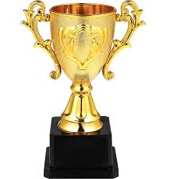
BUT THE CHAMPION???

Slide 16
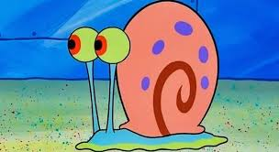

Slide 17
Close!

Slide 18
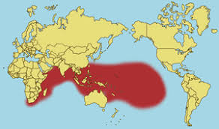
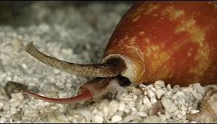
Cone Snails
My FAVORITE Animal!!!

Slide 19
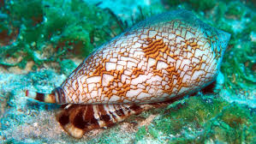
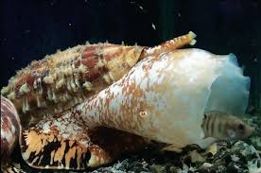
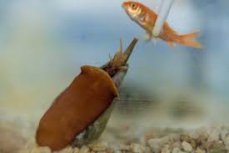
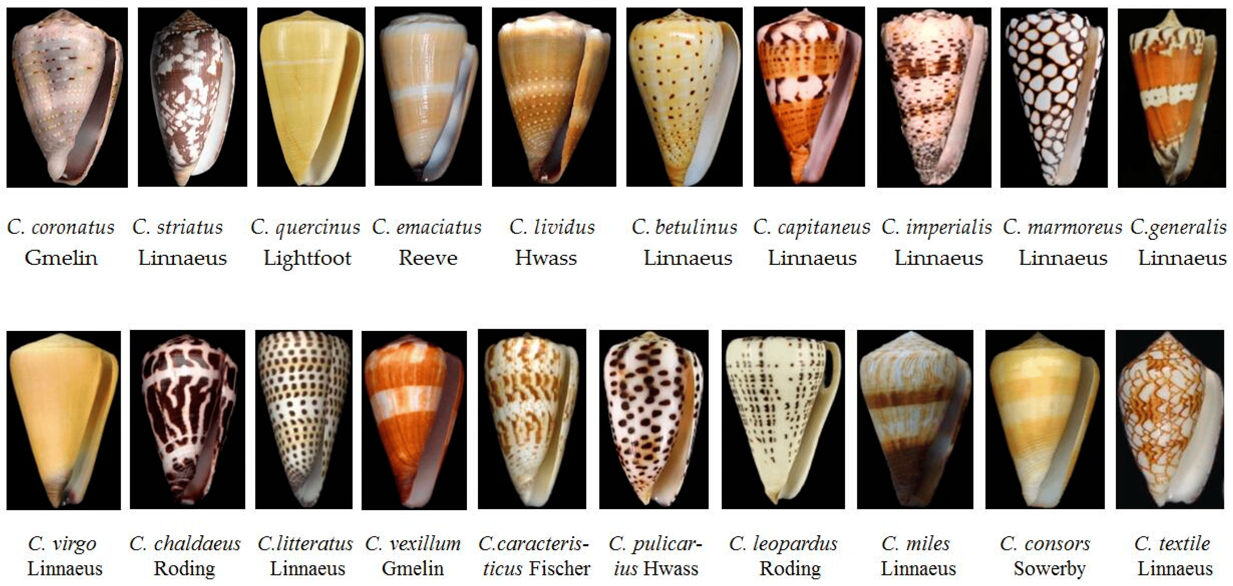

Slide 20
The Facts!
Beautiful, deadly
Harpoon is modified tooth on probiscis. 360 degree range
Stabs, paralyzes, consume food whole
Multiple peptides, many toxins, fragile genome
Small = bee sting like, big = deadly! (1-5 hours)
Geographer Snail = “Cigarette Snail”
No antivenom, supportive care
Paralyze diaphragm, amongst other things
Ziconotide = Non-opiate pain killer, 1,000x more powerful than morphine, intrathecally though
Alzheimer’s? Parkinson's? Epilepsy? Depression?

Slide 21
What can we do with venoms and poisons

Slide 22
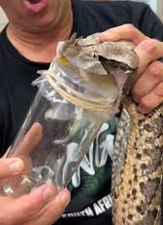
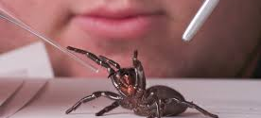
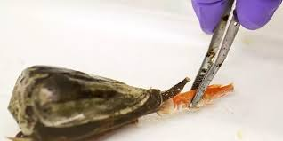
MILKING!!!

Slide 23
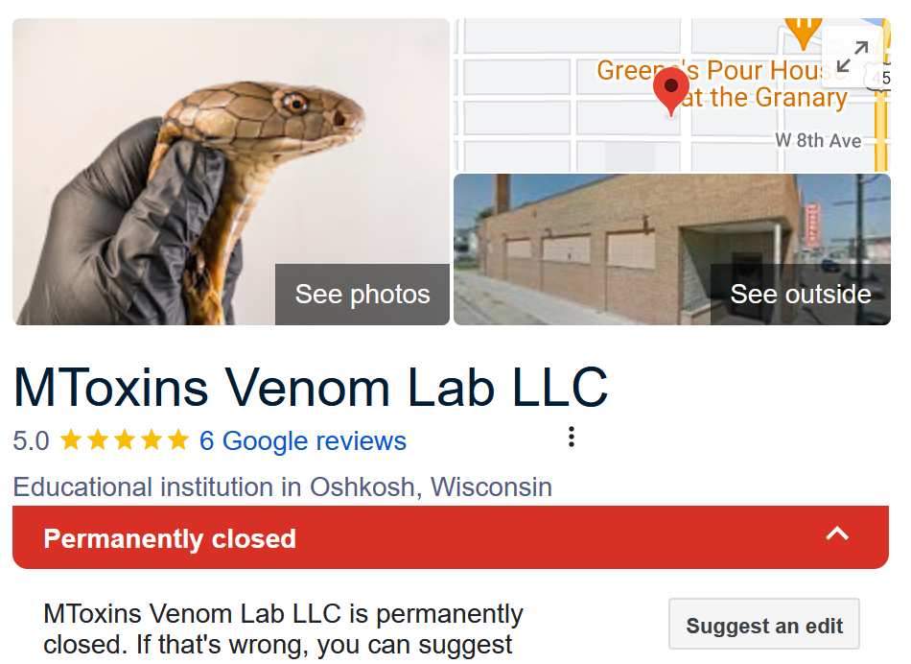

Slide 24
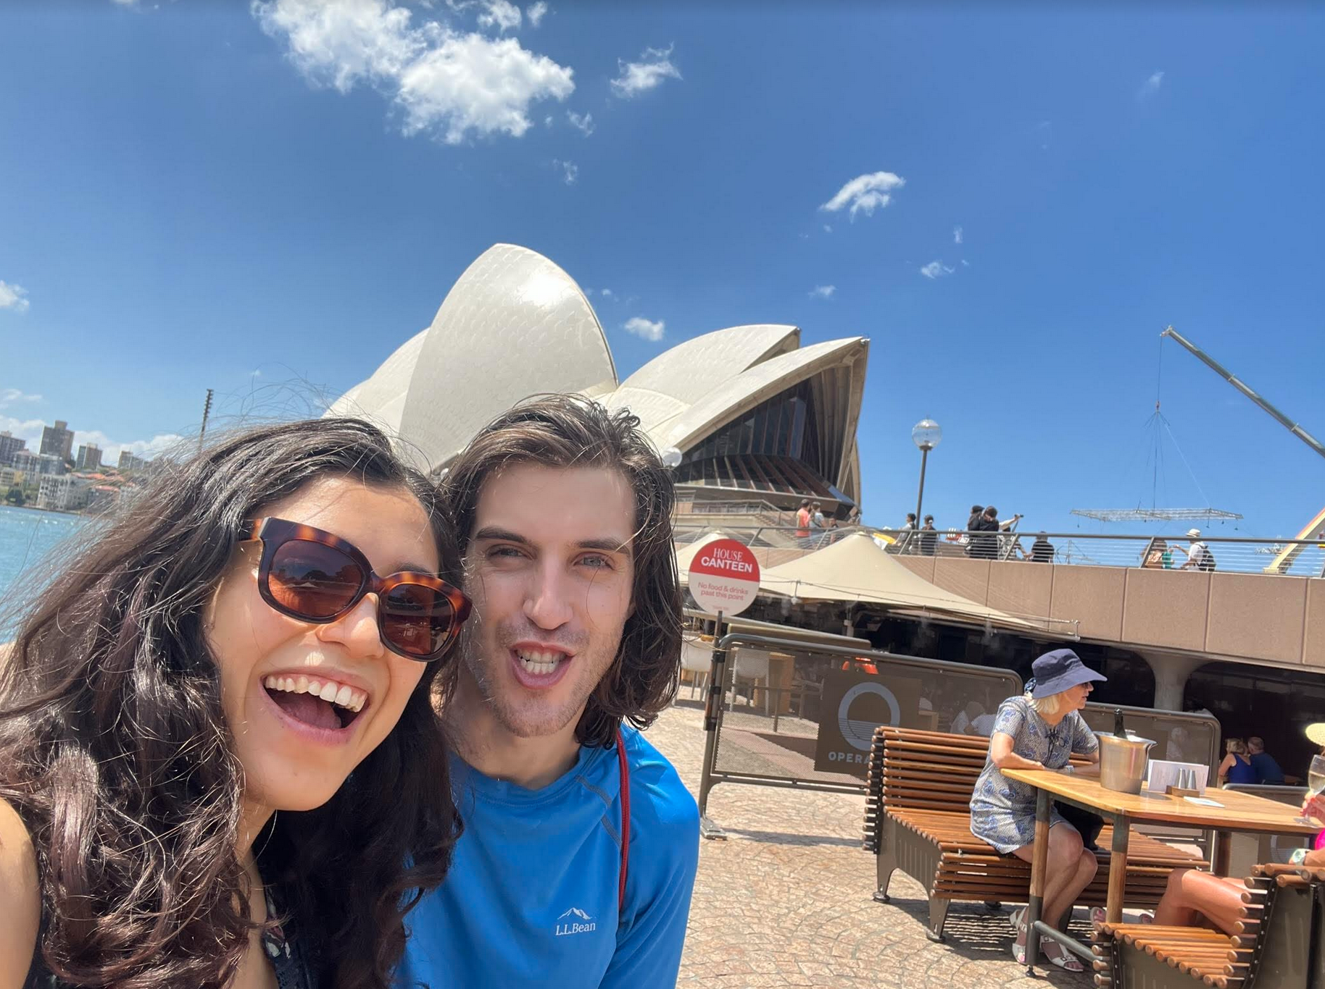
BUT WHAT ABOUT ME!!!

Slide 25
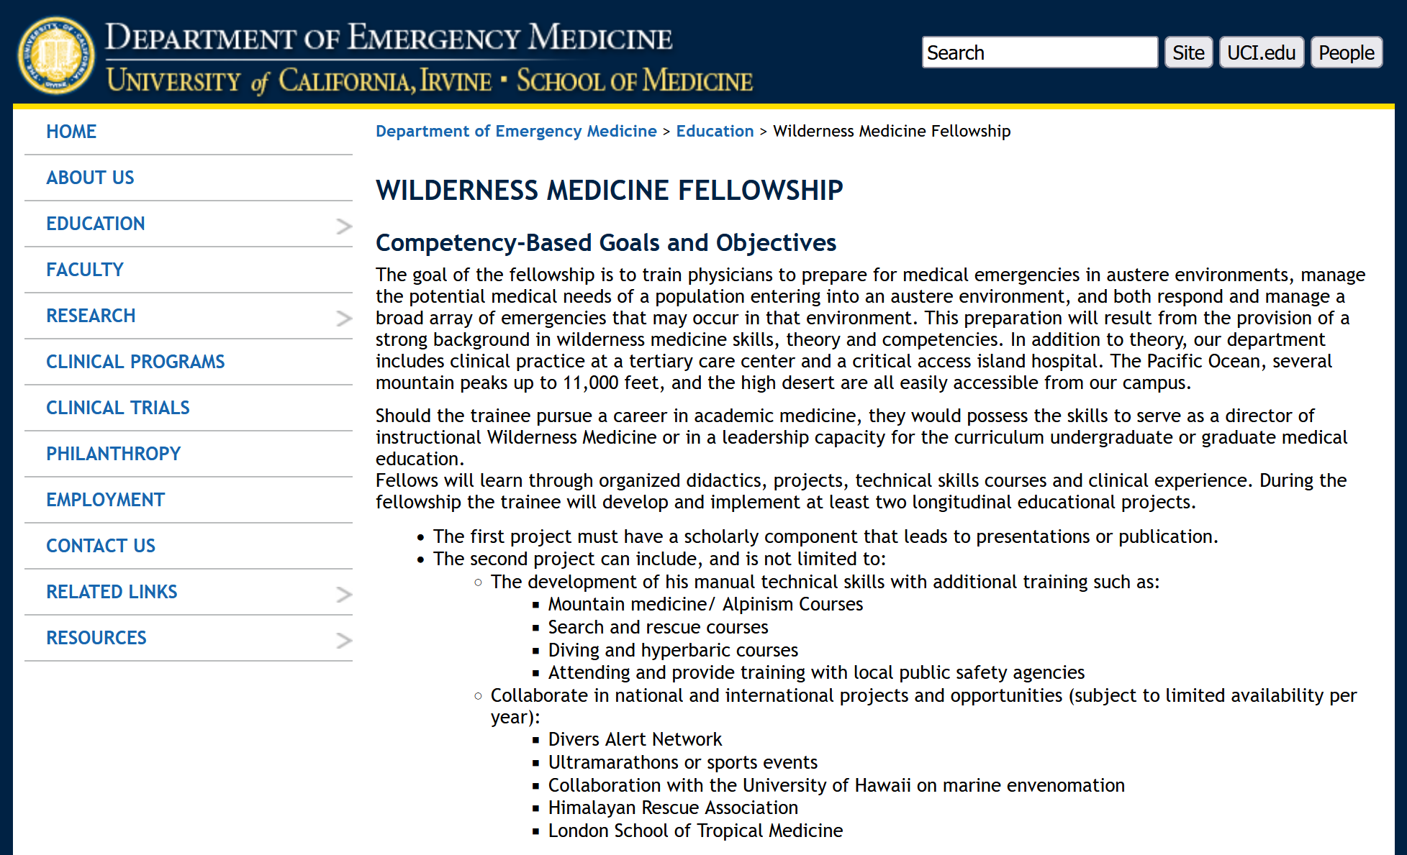

Slide 26
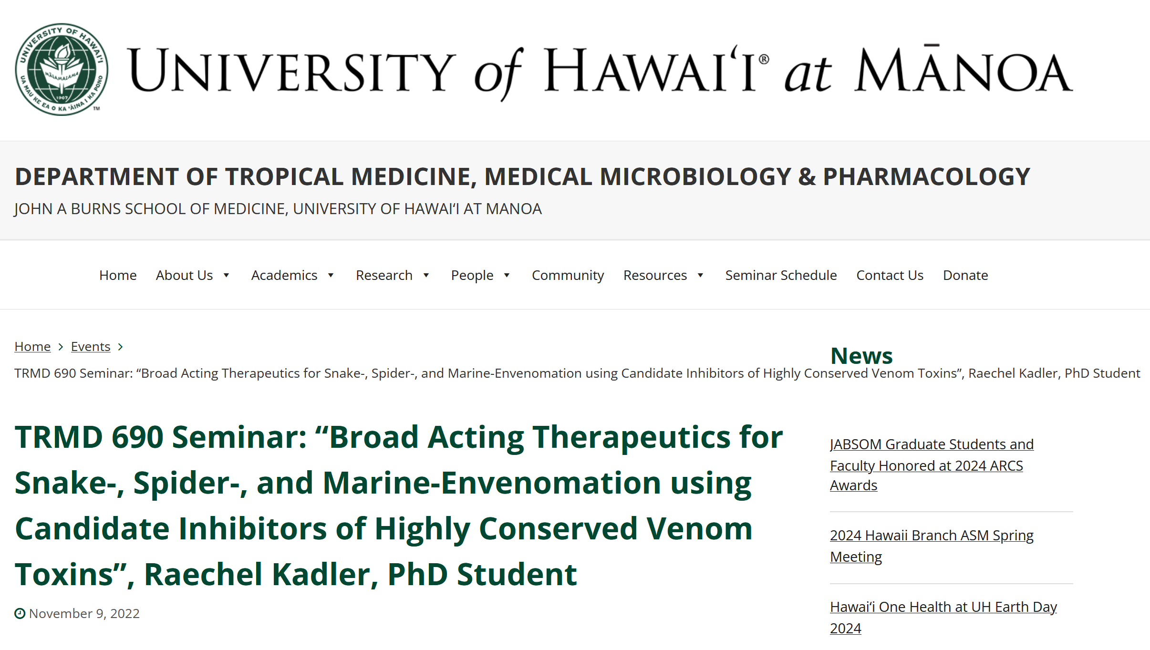

Slide 27
Ian’s Toxic Trait!
…and perhaps the perfect profession!
THANK YOU!!!

