Slide 1
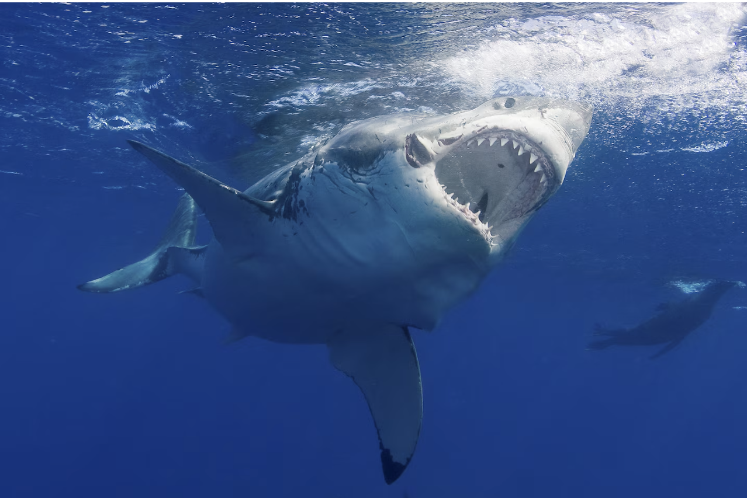
The Great White Shark
By Francisco

Slide 2
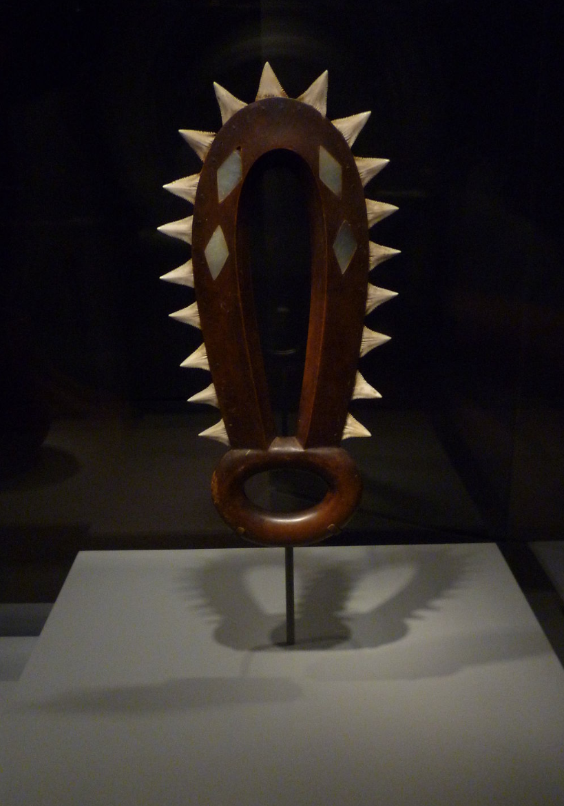
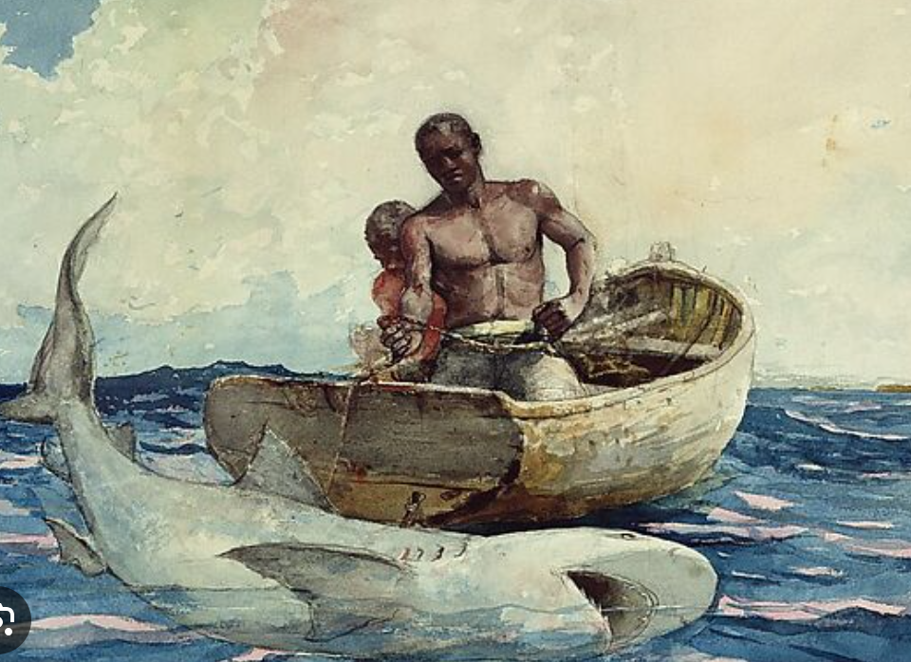
History
Evolved 450-470 Million years ago
Coexisted among various coastal communities
Part of pop culture

Slide 3
Where are Great White Sharks Found?

Slide 4
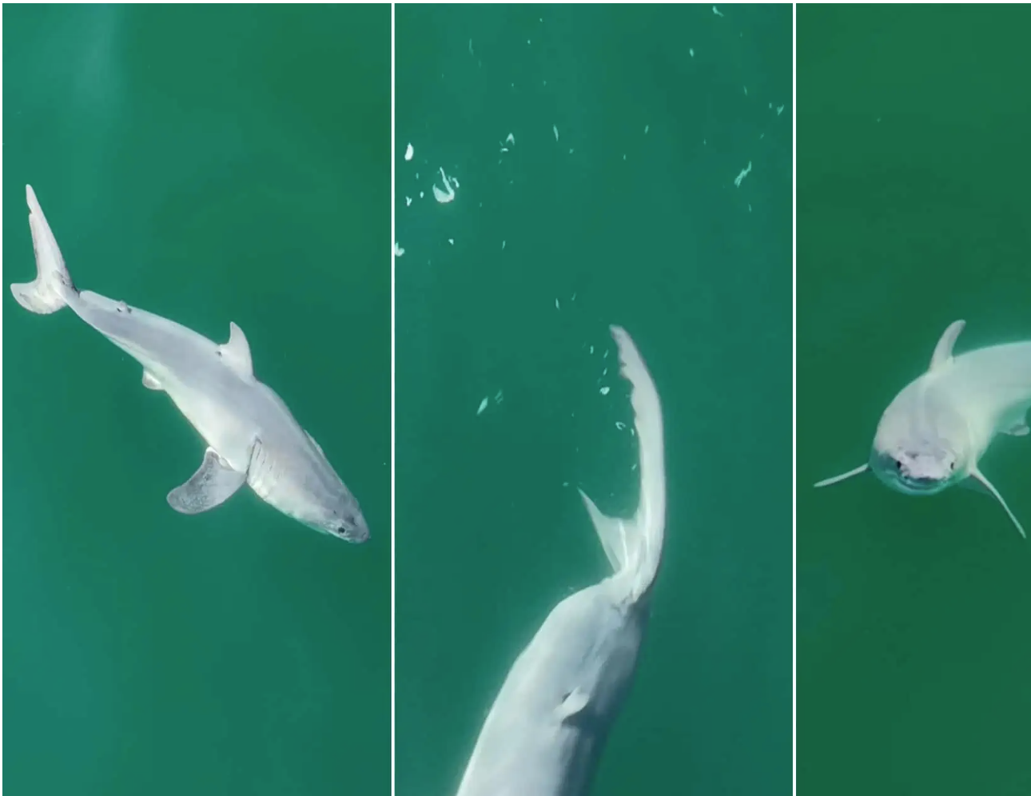
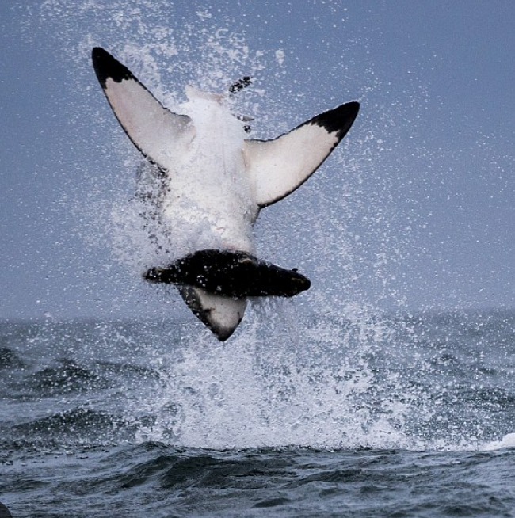
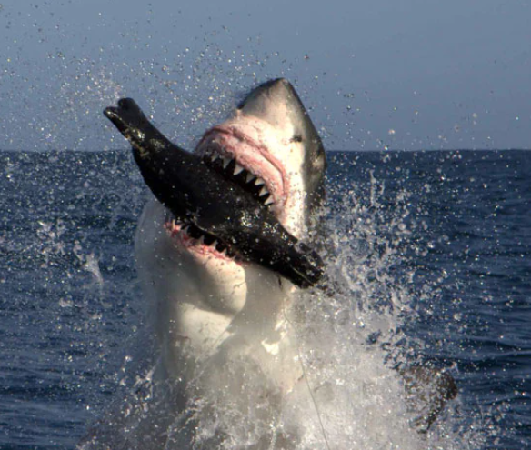
Behaviors
Very Elusive Creatures
Live anywhere from 50ft but can reach depths of 3700 ft (almost a mile).
Mating behaviors and pregnancy highly unknown
Diet includes fish and seals

Slide 5
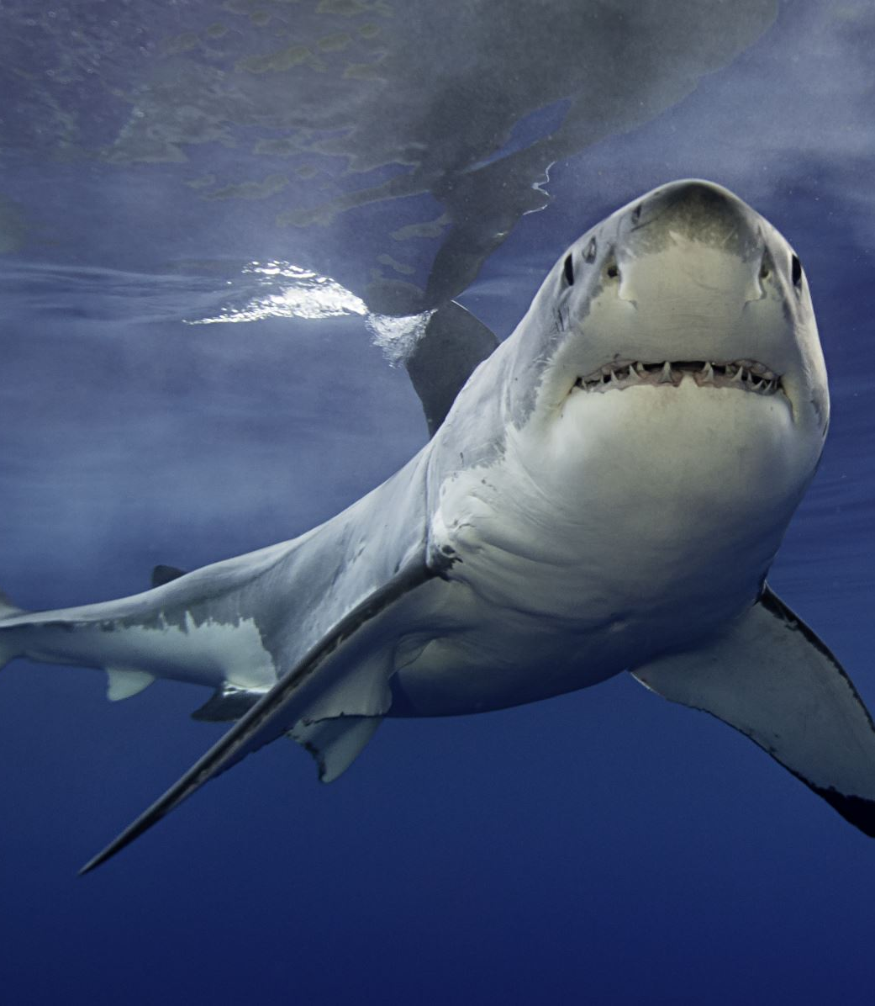
Interactions with humans.
Shark attack chances are 1 in 11.5 million.
Very Rare
Habitat loss has moved them away from certain areas and into new areas where they encounter more humans.
Hunted in areas of Latin America and Asia for variety of reasons.

Slide 6
Trigger Warning

Slide 7
Shark Bites

Slide 8
Natural Predator

Slide 9
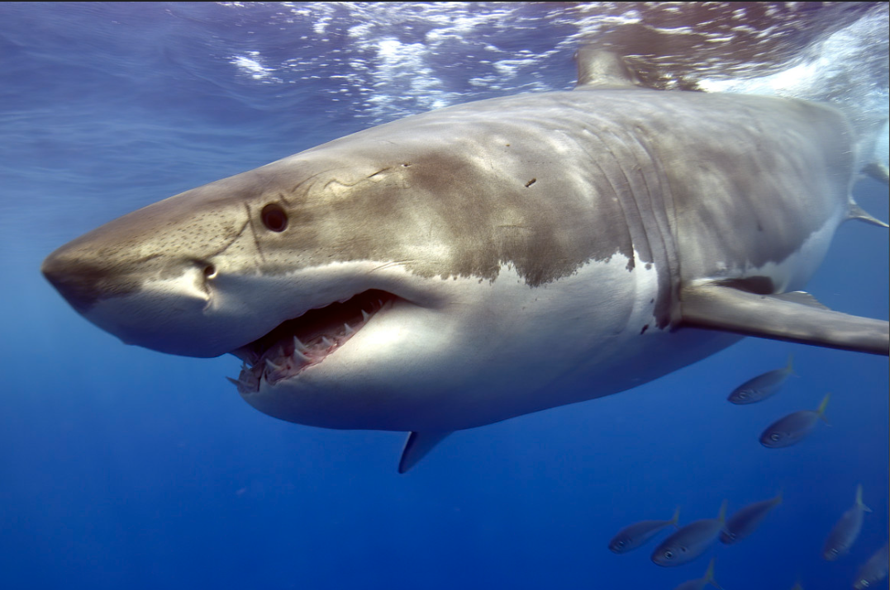
Why Should Sharks Matter to You?
They maintain a healthy ecosystem (keep out invasive species.
Healthy ocean is important to the carbon cycle.
Cancer Research.

Slide 10
Questions? Thank you

